Slide 1

Trench 2 Transaction Score
Presented by:
Data Science
10th April 2025

Slide 2
Architecture Overview of TDB’s Risk Scorecards
For Cash Loan only
For both Cash and SIL
Limit Setting Model (Hosted in Digital Layer)
Credit Decisioning Model (Hosted in Taran)
Beta Stack
Alpha Stack
Trench 1: New Users - within 30 days from TSA Onboarding
Limit Setting Score = Gamma Stack
Beta Demo Score
Beta Demo Score
Gamma Demo Score
Apps Score
Apps Score
Selectively call Alpha
Apps Score
Credo Score
Users automatically move from Trench 1 to Trench 2 after 30 days if no disbursed loans
Credo Score
CIC Score
Gamma Income Model
Beta Income Model
Alpha Income Model
Users will stay in Trench 2 until 1st disbursed loan. His Gamma Stack will be re-calculated every 30-day anniversary from TSA onboarding date
Limit Setting Score = Gamma Stack
Beta Stack
Alpha Stack
Gamma Demo Score
Beta Demo Score
Beta Demo Score
Trench 2: Existing Users - After 30 days from TSA Onboarding AND Never Disbursed Loan
Apps Score
Apps Score
Selectively call Alpha
Apps Score
Transaction Score
Transaction Score
Transaction Score
CIC Score
Gamma Income Model
Beta Income Model
Alpha Income Model
Users will move to Trench 3 after 1st Disbursed Loan
Lowest Risk users from this B Score will be pre-approved for upsell and xsell. Medium Risk users from this B Score will have to go through Taran.
High Risk users from this B Score will not be given any offer.
B Score = Gamma Stack
Trench 3: Existing Users - After 30 days from 1st Disbursed Loan AND current DPD <= 10
Beta Stack
Alpha Stack
Gamma Demo Score
Apps Score
Beta Demo Score
Beta Demo Score
Apps Score
Apps Score
Enhanced Transaction Score
Selectively call Alpha
Enhanced Transaction Score
Once moved to Trench 3, user will forever remain in Trench 3. His Gamma Stack will be re-calculated every 30 days anniversary from 1st Loan Disbursement Date
Enhanced Transaction Score
CIC Score
Gamma Income Model
Beta Income Model
Alpha Income Model

Slide 3
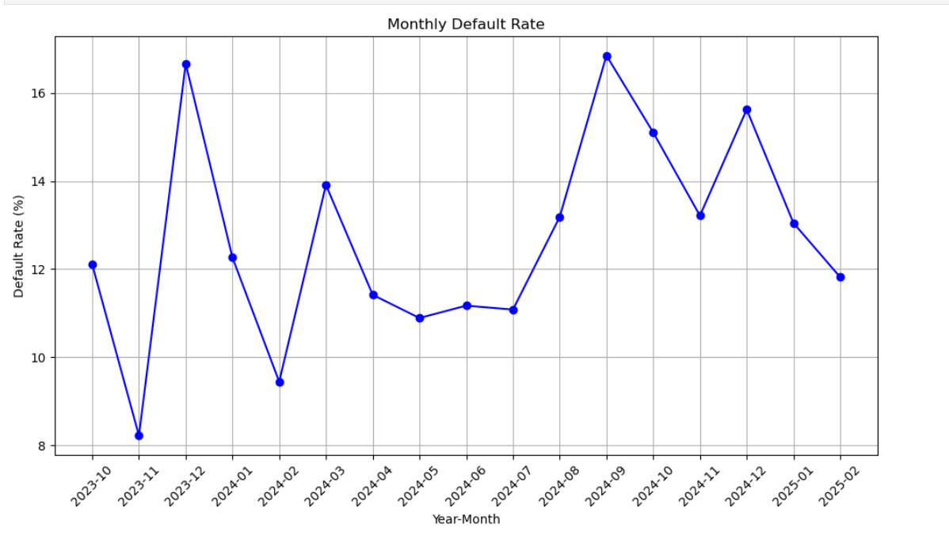
Cash Loan Gamma Transaction Scorecard was developed on Trench 2 users (30+ DOB users without any disbursed loan before)
 | Loan Disbursement Date | # count | # Bad (FPD30) Quick Loans | FPD30 rate
Training (90%) | 06/10/2023 - 31/10/2024 | 5173 | 703 | 0.1359
Validation (10%) | 06/10/2023 - 31/10/2024 | 575 | 84 | 0.1461
Nov(Test) | 01/11/2024 - 30/11/2024 | 1294 | 171 | 0.1321
Dec (OOT) | 01/12/2024 - 31/12/2024 | 768 | 120 | 0.1562
Jan (OOT) | 01/01/2025 - 31/01/2025 | 889 | 116 | 0.1305
Feb (OOT) | 01/02/2025 - 14/02/2025 | 440 | 52 | 0.1182
FPD30 rate over the month

Slide 4
Feature Selection Methodology Overview
Feature Selection Methodology Overview
238
Feats
105
Feats
94 Feats
50 Feats
12 Feats
IV > 0.008
Missing Rate < 95%
Inter-correlation < 75%
Individual Feature Evaluation

Slide 5
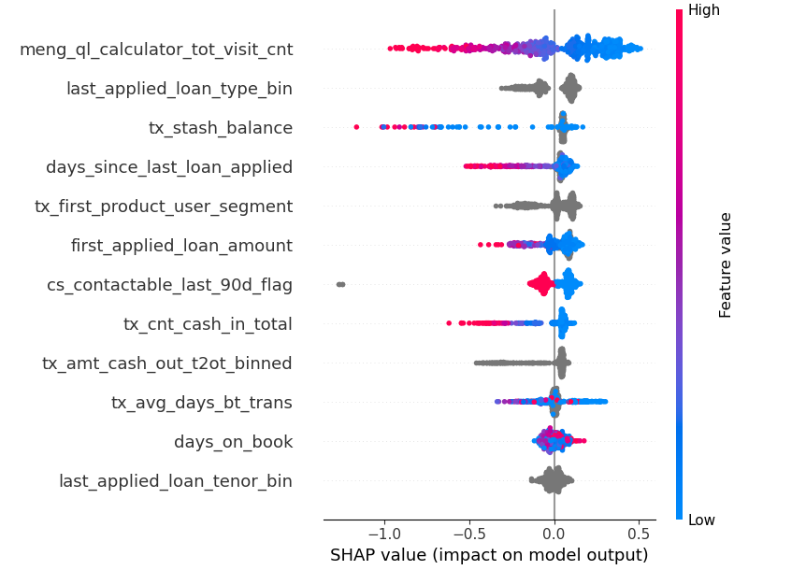
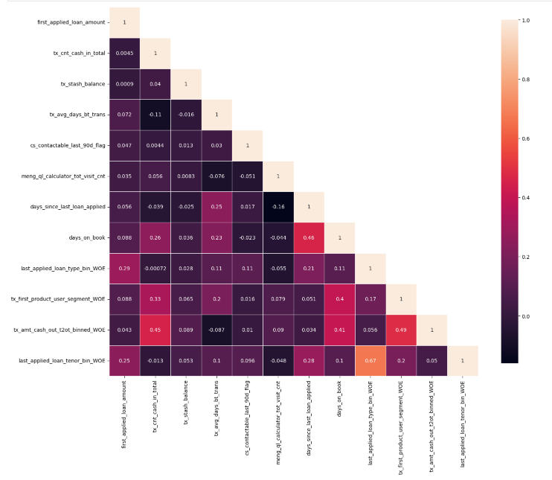
SHAP(12 feat)
Inter-Correlation (12 feat)

Slide 6
@pradeepa: Update this slide
Model Iteration | Top Features | Train Gini (2023-10-06- 2024-10-31) | Val Gini | Nov Gini | Dec Gini | Jan Gini | Feb Gini (01-02-2025 - 14-02-2025)
Model with top 8 feat | meng_ql_calculator_tot_visit_cnt | 0.4577 | 0.317 | 0.3238 | 0.3105 | 0.4438 | 0.3324
 | cs_contactable_last_90d_flag
 | last_applied_loan_type_bin
 | first_applied_loan_amount
 | tx_amt_cash_out_t2ot_binned
 | tx_cnt_cash_in_total
 | tx_avg_days_bt_trans
 | tx_stash_balance
Model with top 9 feat | days_since_last_loan_applied | 0.4941 | 0.324 | 0.3057 | 0.3162 | 0.4605 | 0.3087
Model with top 10 feat | days_on_book | 0.4983 | 0.329 | 0.3109 | 0.3103 | 0.4485 | 0.3017
Model with top 11 feat | tx_first_product_user_segment | 0.4937 | 0.3306 | 0.3042 | 0.3043 | 0.4464 | 0.2929
Model with top 12 feat | last_applied_loan_tenor_bin | 0.503 | 0.3263 | 0.3065 | 0.3142 | 0.4501 | 0.2959
Model with top 13 feat | tx_cnt_incomplete_loan_apps | 0.4879 | 0.3332 | 0.3116 | 0.3053 | 0.4457 | 0.3024
Model with top 14 feat | existing_user_type | 0.487 | 0.321 | 0.3098 | 0.3056 | 0.4512 | 0.3047
12 feature model after Hyper Parameters Tuning |  | 0.4607 | 0.3234 | 0.3004 | 0.2989 | 0.4475 | 0.3144

Slide 7
Model Iteration | Top Features | Train Gini (2023-10-06- 2024-10-31) | Val Gini | Nov Gini | Dec Gini | Jan Gini (01-01-2025 - 29-01-2025)
Model with top 8 feat | meng_ql_calculator_tot_visit_cnt | 0.3927 | 0.2797 | 0.2574 | 0.2462 | 0.4011
 | tx_amt_cash_out_t2ot_binned
 | tx_stash_balance
 | last_applied_loan_type_bin
 | days_since_last_loan_applied
 | first_applied_loan_amount
 | cs_contactable_last_90d_flag
 | tx_first_product_user_segment
Model with top 9 feat | tx_cnt_cash_in_total | 0.4099 | 0.2801 | 0.2577 | 0.2502 | 0.4045
Model with top 10 feat | tx_avg_days_bt_trans | 0.4242 | 0.2979 | 0.2735 | 0.2582 | 0.4164
Model with top 11 feat | days_on_book | 0.5132 | 0.2817 | 0.2733 | 0.2655 | 0.4139
Model with top 12 feat | last_applied_loan_tenor_bin | 0.497 | 0.2811 | 0.2674 | 0.2725 | 0.4171
Model with top 13 feat | tx_cnt_incomplete_loan_apps | 0.4954 | 0.288 | 0.2787 | 0.2647 | 0.4084
Model with top 14 feat | cic_CreditAvgCreditLimit' | 0.4897 | 0.2711 | 0.2854 | 0.2646 | 0.4073
Model with top 15 feat | existing_user_type | 0.4292 | 0.2693 | 0.2763 | 0.2602 | 0.4017
12 feature model after Hyper Parameters Tuning |  | 0.4555 | 0.3061 | 0.2700 | 0.2738 | 0.4252

Slide 8
Feature Evaluation Plots (12 features)

Slide 9
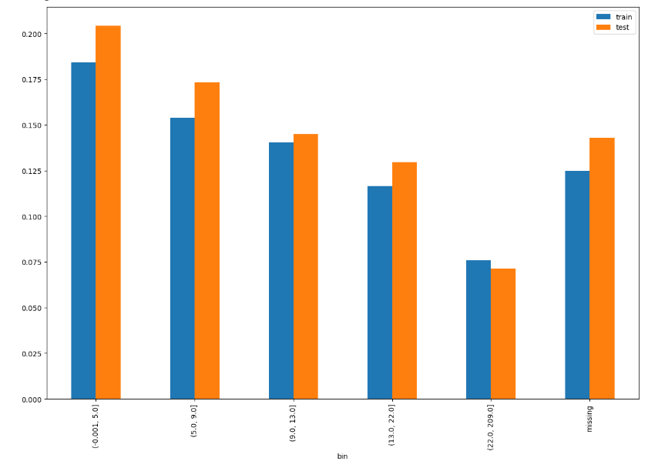
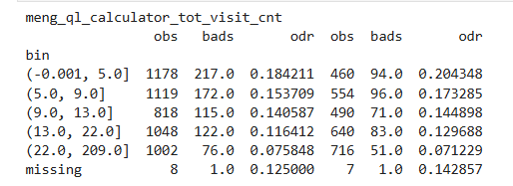
meng_ql_calculator_tot_visit_cnt SHAP Rank: 1 Number of times the user have visited the Loan Calculator Page

Slide 10
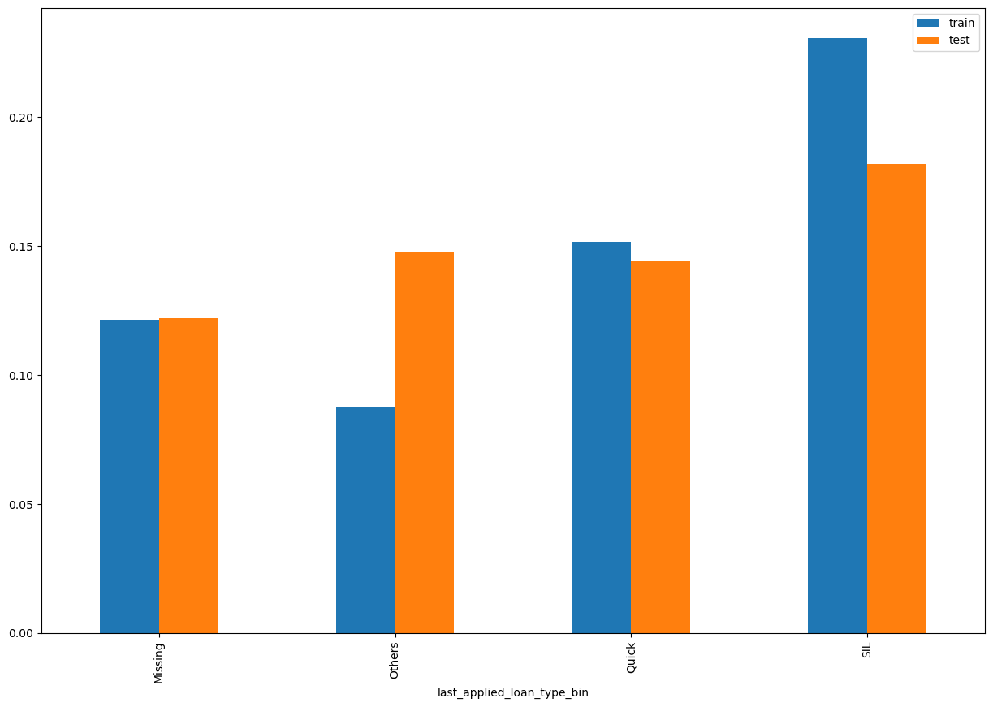
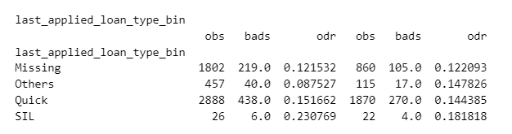
last_applied_loan_type_bin SHAP Rank: 2 It refers to the loan type the user last applied for

Slide 11
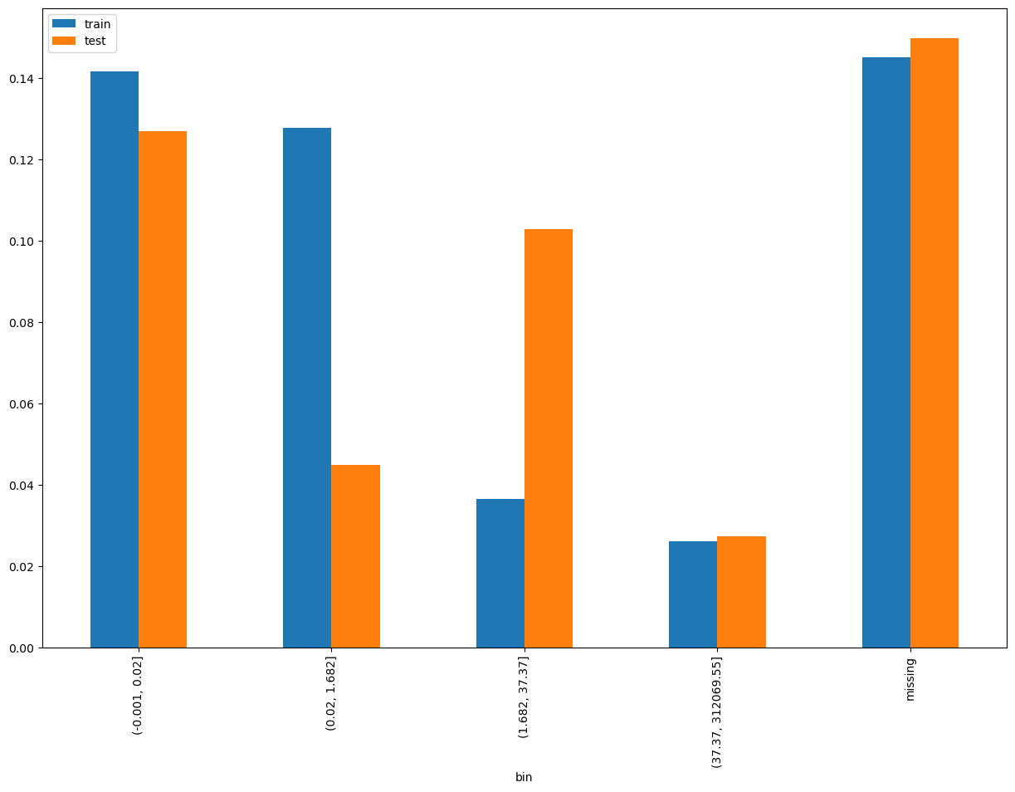
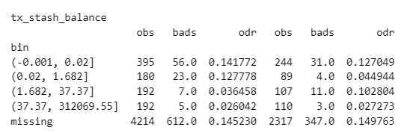
tx_stash_balance SHAP Rank: 3 Unique balances from "Stash" accounts for each customer

Slide 12
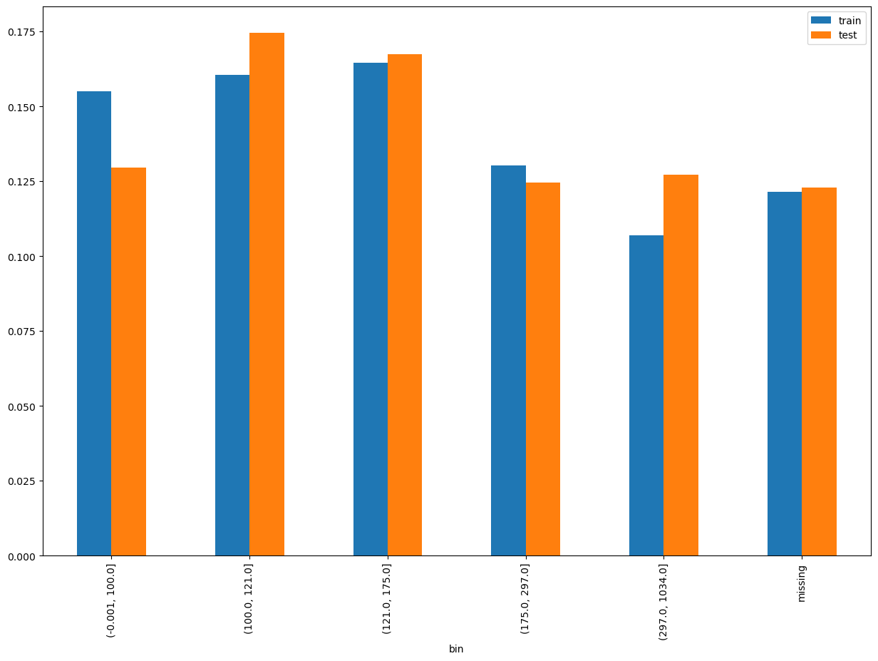
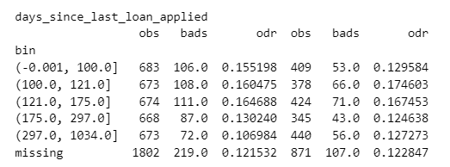
days_since_last_loan_applied SHAP Rank: 4 (ln_application_submit_time – last_applied_loan_appln_time)

Slide 13
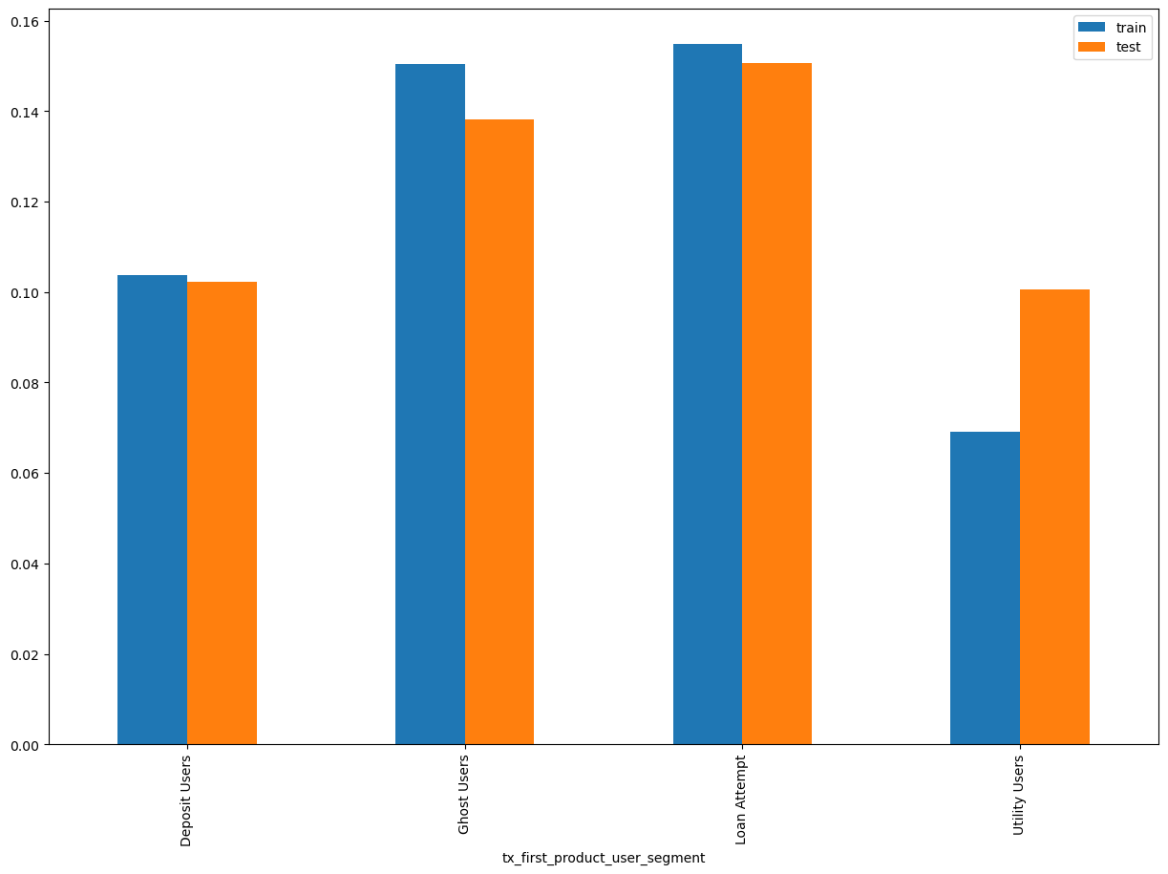
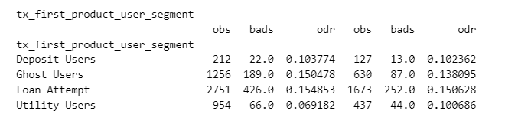
tx_first_product_user_segment SHAP Rank: 5 It classifies users based on their first product interaction

Slide 14
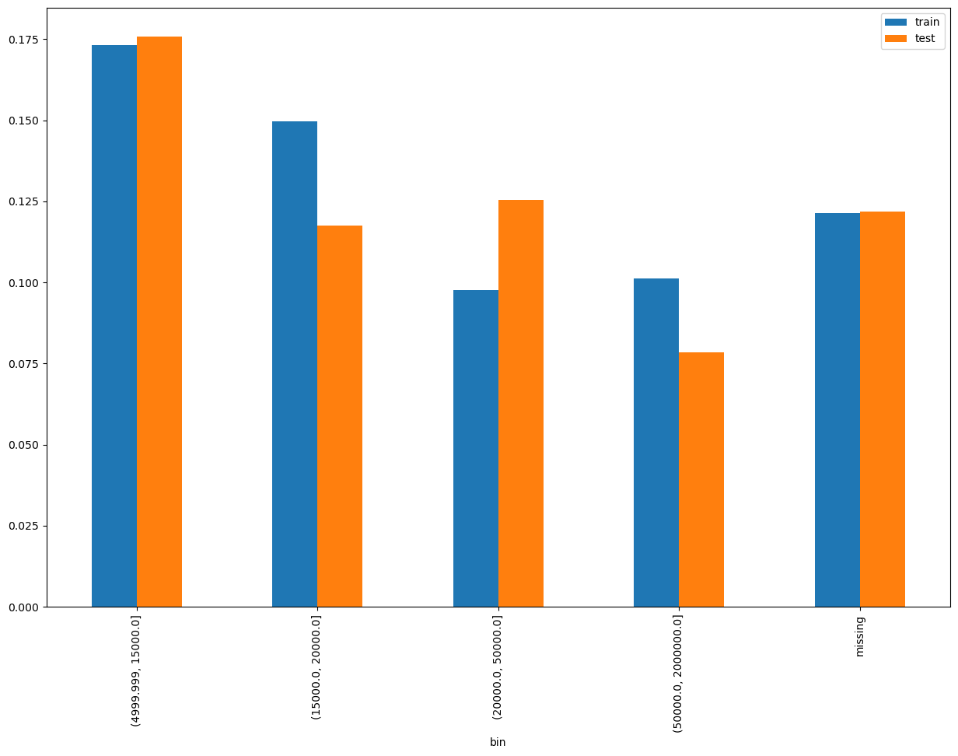
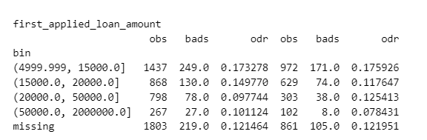
first_applied_loan_amount SHAP Rank: 6 Loan amount that a user applied for in their first reject loan application

Slide 15
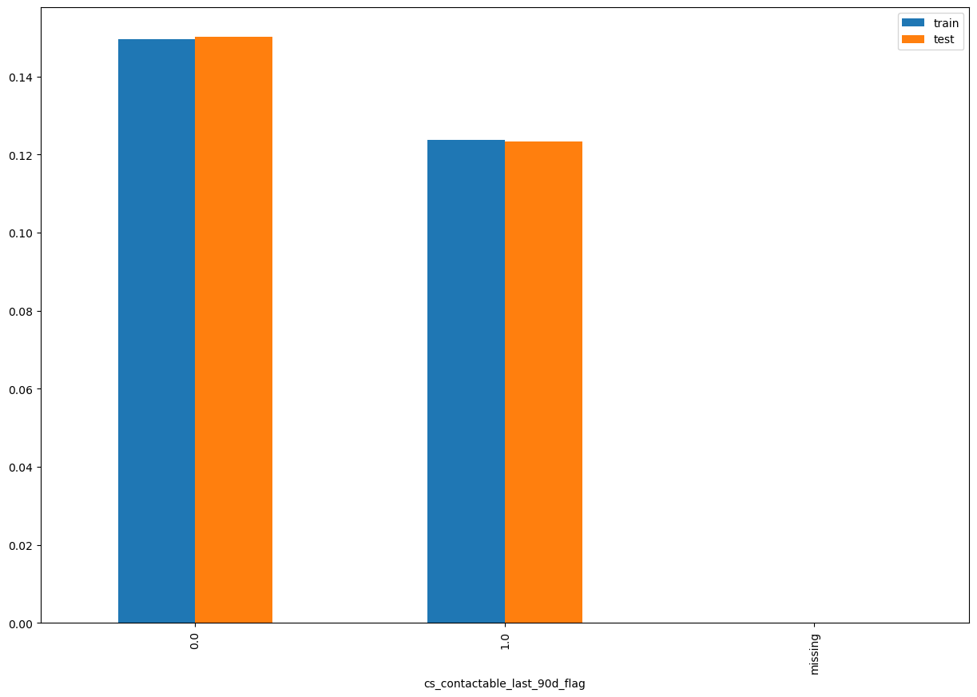
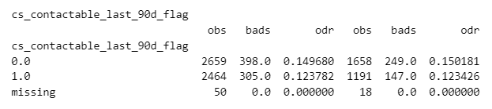
cs_contactable_last_90d_flag SHAP Rank: 7

Slide 16
Camp_group | flag_contactable_last90D | count_contactable_last90D | cnt_records
3.3 B3 | 1 | 1 | 1
5. Reference | 1 | 1 | 17
5. Reference | 1 | 2 | 1
other - NO CAMPAIGN NAME | 0 | 0 | 33669
other - BIG LOANS Campaign | 1 | 1 | 1
other - NO CAMPAIGN NAME | 1 | 9 | 25
other - NO CAMPAIGN NAME | 1 | 6 | 120
other - NO CAMPAIGN NAME | 1 | 12 | 7
other - NO CAMPAIGN NAME | 1 | 8 | 40
other - NO CAMPAIGN NAME | 1 | 14 | 5
other - NO CAMPAIGN NAME | 1 | 21 | 1
other - NO CAMPAIGN NAME | 1 | 5 | 204
other - NO CAMPAIGN NAME | 1 | 11 | 10
other - NO CAMPAIGN NAME | 1 | 7 | 58
other - NO CAMPAIGN NAME | 1 | 32 | 1
other - NO CAMPAIGN NAME | 1 | 10 | 19
other - NO CAMPAIGN NAME | 1 | 29 | 1
other - NO CAMPAIGN NAME | 1 | 15 | 7
other - NO CAMPAIGN NAME | 1 | 13 | 3
other - NO CAMPAIGN NAME | 1 | 24 | 1
other - NO CAMPAIGN NAME | 1 | 26 | 1
other - NO CAMPAIGN NAME | 1 | 19 | 2
other - NO CAMPAIGN NAME | 1 | 17 | 2
other - NO CAMPAIGN NAME | 1 | 28 | 2
other - NO CAMPAIGN NAME | 1 | 16 | 1
other - NO CAMPAIGN NAME | 1 | 1 | 10207
other - NO CAMPAIGN NAME | 1 | 2 | 2263
other - NO CAMPAIGN NAME | 1 | 3 | 819
other - NO CAMPAIGN NAME | 1 | 4 | 360
other - OB DST | 1 | 1 | 1
other - OB RTCC April 29 | 1 | 1 | 227
other - OB RTCC April 29 | 1 | 2 | 22
other - OB RTCC April 29 | 1 | 3 | 2
other - OB RTCC April 29 | 1 | 4 | 1
other - OB RTCC August 13 | 1 | 1 | 50
other - OB RTCC August 13 | 1 | 2 | 4
other - OB RTCC DECEMBER 15 | 1 | 1 | 19
other - OB RTCC NOVEMBER 26 | 1 | 1 | 11
other - OB RTCC NOVEMBER 26 | 1 | 2 | 1
other - OB RTCC OCTOBER 28 | 1 | 1 | 2
other - OB RTCC OCTOBER 30 B3 | 1 | 1 | 1
other - OB Zip Code BTS | 1 | 1 | 1
other - ONBOARDING DROP-OFFS | 1 | 1 | 1
other - RTCC APRIL 3 | 1 | 1 | 4
other - RTCC MAY 5 B1 | 1 | 1 | 1
other - RTCC MAY 6 B1 | 1 | 1 | 2
Outbound call types for this Contactability Feature

Slide 17
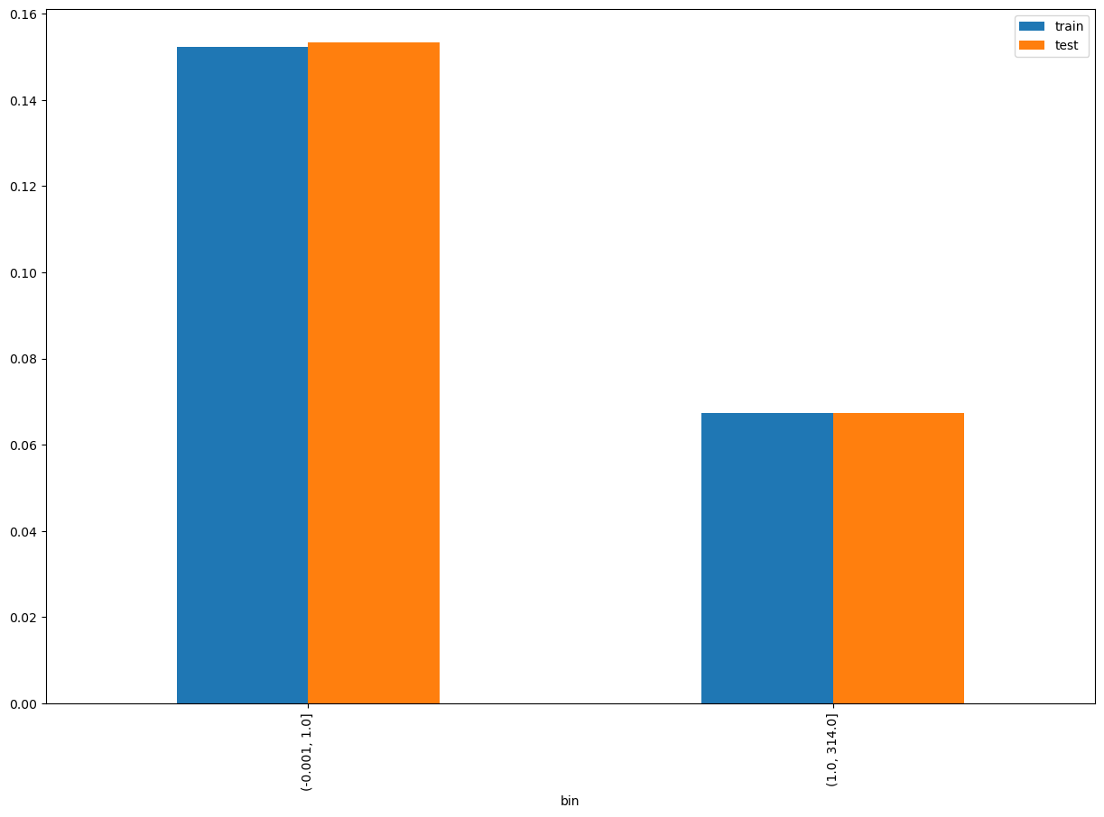
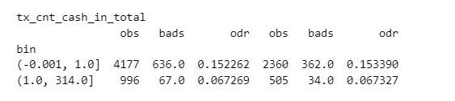
tx_cnt_cash_in_total SHAP Rank: 8

Slide 18
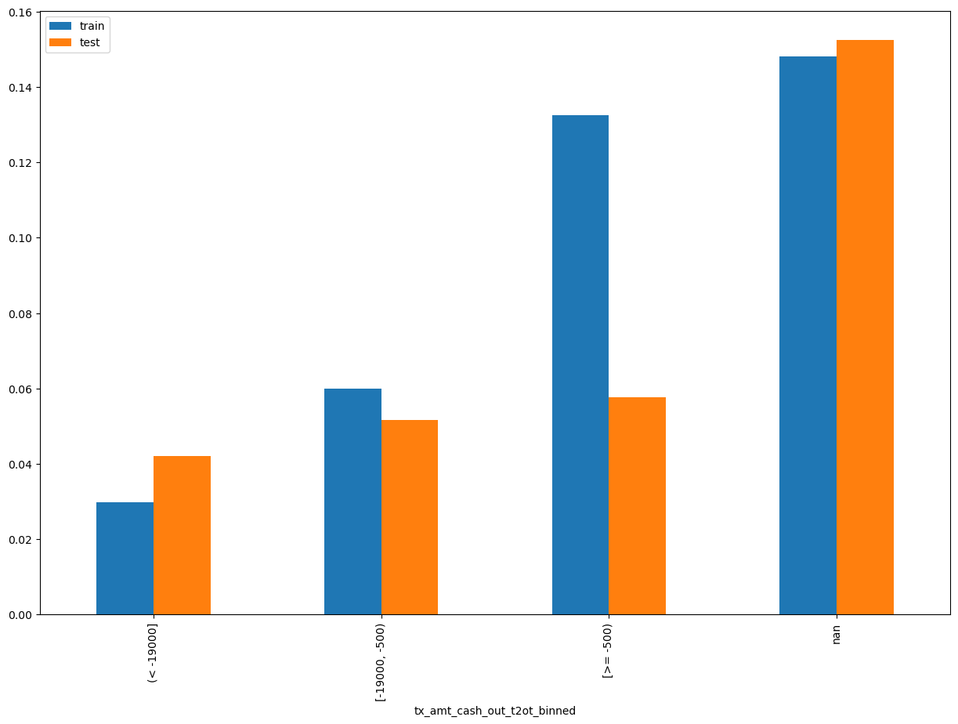
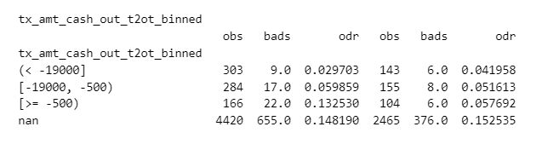
tx_amt_cash_out_t2ot_binned SHAP Rank: 9 The total cash-out transaction amount for transfers from "Own TSA to Other Tonik" accounts.

Slide 19
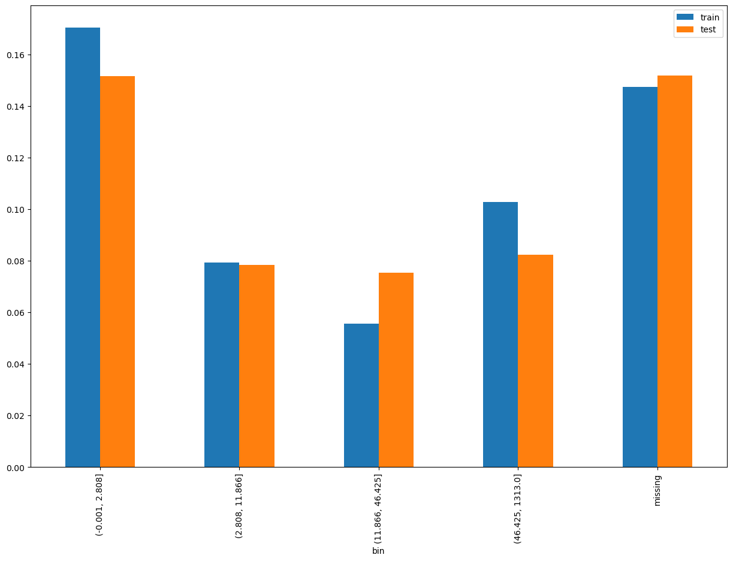
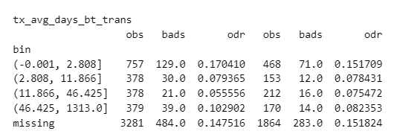
tx_avg_days_bt_trans SHAP Rank: 10 The average day difference between the consecutive transactions.

Slide 20
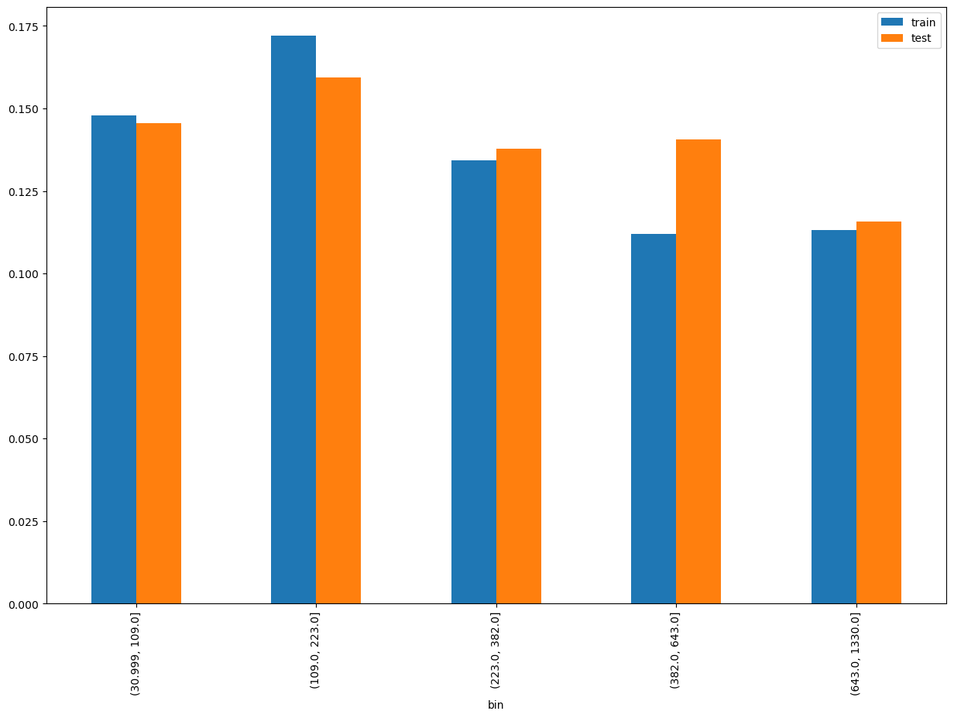
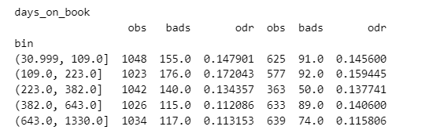
days_on_book SHAP Rank: 11 (ln_application_submit_time - onboarding_date)

Slide 21
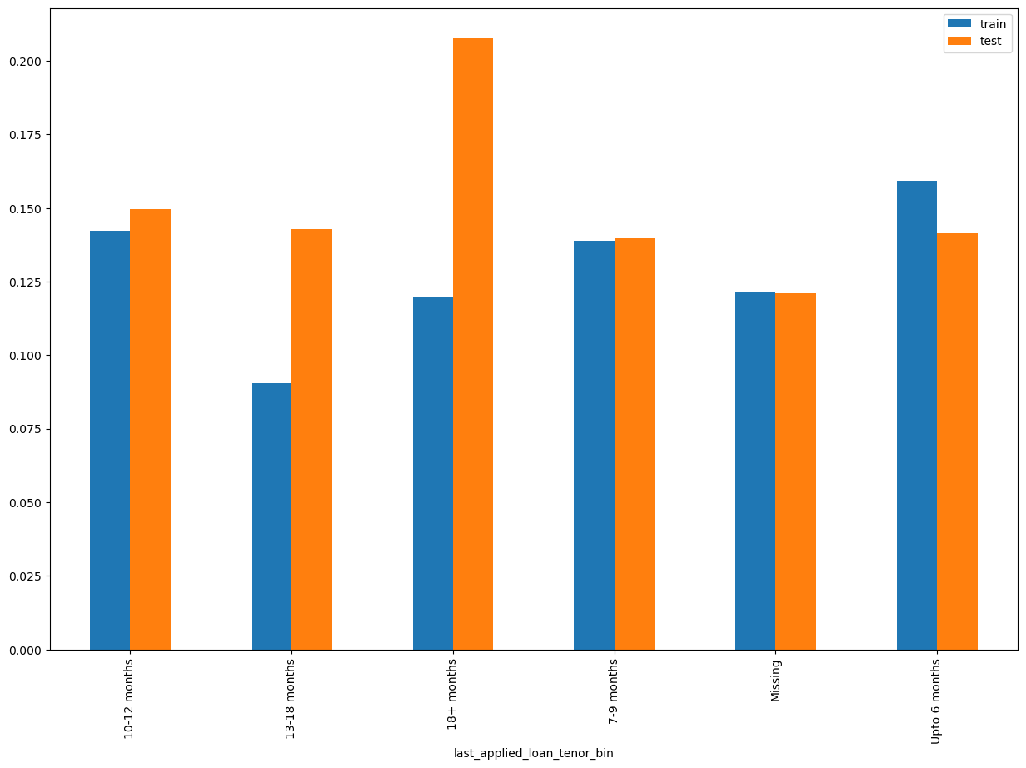
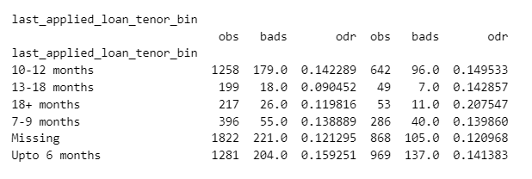
last_applied_loan_tenor_bin SHAP Rank: 12 It refers to the duration or term of the loan

Slide 22

THANK YOU!
​
Questions?
tonikbank.com

